Slide 1
STAKEHOLDER SESSSION
Complying With The OQSF

Slide 2
Referencing the QCTO: Mandates
QCTO Mandate as per the Skills Development Act
The QCTO mandate is outlined in the Skills Development Act No. 97 of 1998, as amended. Section 26H of the ACT outlines the functions of QCTO.
QCTO Mandate as per the National Qualifications Framework Act
Section 27(i) - With regards to quality assurance within its sub-framework
develop and implement policy for quality assurance;
ensure the integrity and credibility of quality assurance; and
Ensure that such quality assurance as is necessary for the sub-framework is undertaken.

Slide 3
Government Gazette – Directive 3rd July 2024
1. Active Legacy Qualifications are Extended by (2 Years) to 30th June 2027
Condition 1: Learnership NOT YET Realigned to OC.
Condition 2: Learnership is Active & has Registered Learners.
2. Expired Occupational Qualifications are Extended to 31st Dec 2025.
Condition: OC Has NOT YET Been Reviewed
**IMPORTANT NOTES**
VISION 2027
No Extensions Post 2027
(DHET/SAQA/QCTO)
INSETA TRANSITION DEADLINE:
30th June 2026
OC: 91784 End Date
OC: 117329 - Hello

Slide 4
Implementing The OQSF - Domains
Domain 1 – Qualification Development
Rationale:
Qualification Maintenance:
Subject Matter Experts:
Regulatory Compliance:
Learnership Registration:
Specific Occupations:

Slide 5
 | REGISTERED OCCUPATIONAL QUALIFICATION TITLE | SAQA ID NUMBER | Learnership Reg..
1 | Insurance Agent: Insurance Underwriter NQF Level 5 | 91784 | Yes
2 | Insurance Agent: Insurance Underwriter NQF Level 5 | 117329 | Pending
3 | Financial Advisor NQF Level 6 | 105026 | Yes
4 | Long-Term Insurance Advisor NQF Level 5 | 105021 | Yes
5 | Health Care benefits Advisor NQF Level 5 | 105025 | Yes
6 | Investment Advisor NQF Level 5 | 105022 | Yes
7 | Employee & Pension Funds Benefits Advisor NQF Level 5 | 105030 | Yes
8 | Claims Administration: Claims Assessor NQF Level 4 | 99668 | Yes
9 | Organisational Risk Manager NQF Level 8 | 97387 | Not Yet
10 | Organisational Risk Practitioner NQF Level 6 | 94222 | Yes
11 | Professional Principal Executive Officer NQF Level 7 | 93602 | Not Yet
12 | Professional Principal Executive Officer (Retirement Fund Trustee) NQF L05 | 99574 | Yes

Slide 6
Domain 1 - Qualification Development: Update
Re-Alignment & Review
ORGANISATION (QDF) | OCCUPATIONAL QUALIFICATIONS | ETA
IISA | Short-Term Insurance Practitioner Claims Assessor (Review) Insurance Administrator (New) | 31st Dec 2024 – Development 31st March 2024 – SAQA Reg.
FPI | Long-Term Insurance Practitioner Wealth Management | 30th Nov 2024 – Development 28th Feb 2024 – SAQA Reg
PENDING – Short Skills Programs | Financial Products Seller Insurance Risk Profiler Underwriter Assistant (Drone Pilot) Claims Assessor Assistant (Drone Pilot) | Applications Approval Stage Appointment of QDF

Slide 7
Implementing The OQSF - Domains
Domain 2 - Accreditations
APPLICATION
PROCESS OVERVIEW:
SDP Applies Online Directly to QCTO (www.qcto.org.za).
QCTO Issues a Link to Upload Documents (Check Spam).
QCTO Conducts Desktop Evaluations.
QCTO Instructs SETA to Conduct Site Visit.
SETA Schedules Site Visit with Applicant SDP.
SETA Issues Recommendation Report to QCTO.
QCTO Gives Feedback Directly to Applicant SDP.
Accreditation Fees – Details to Follow.
Delay Issues
3 Months
QCTO FEEDBACK

Slide 8
Domain 2 - Performance Update
QCTO ACCREDITATIONS | DISTRIBUTION AS AT 31st AUG 2024
Training Providers (SDPs) (TOTAL = 96) | Old INSETA Providers = 57 New SDPs = 39 (Transformation)
Assessment Centres (TOTAL = 26) | Gauteng = 10 (Selby, Sandton, Pretoria) Free State = 1 (Bloemfontein) KZN = 3 (Durban) Western Cape = 5 (Belville & George) Limpopo = 2 (Tzaneen & Polokwane) Eastern Cape = 4 (Mt Free, Umtata & Gqeberha)
Accreditation:
Host Employer - Workplace Approval
(Process Development Stage at QCTO)

Slide 9
Implementing The OSF - Domains
Domain 3 – Quality Assurance
(Implementing Training)
IMPORTANT:
SDP Register Learners (LEISA) Directly with QCTO – 21 Days After Commencement of Training.
Training To Comply with OC Rules (Theory / Practical & Workplace) - Notional Hours Apply.
QCTO/SETA Will Conduct Monitoring/EISA Readiness Support.
All Training Must Be Aligned To The Curriculum Document.
HR Requirements of Facilitator/Assessor/Moderator Included In The Curriculum Document.

Slide 10
Training Breakdown - 2024
RPL = 165
Other = +140
Registered Learners for Occupational Qualifications
(31st Aug 2024)

Slide 11
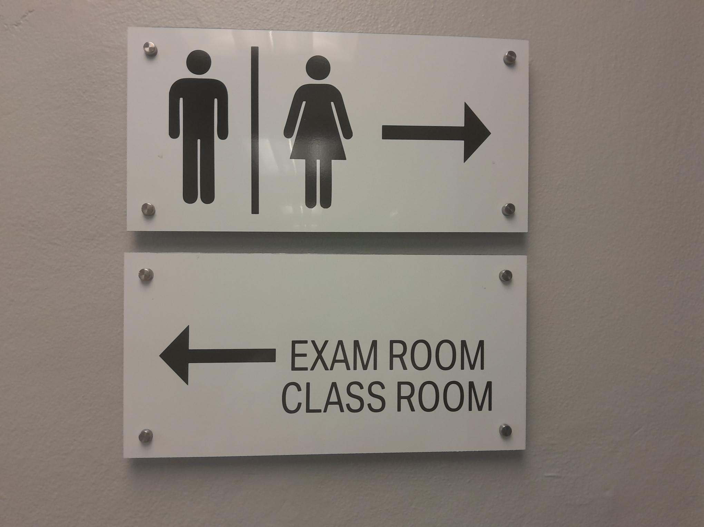
Implementing The OSF - Domains
Domain 4 - Assessments
During Training, Formatives & Tasks Apply for the Development of PoEs.
SDPs Must Enter Candidates for every EISA - SDPs to Submit EISA Packs.
QCTO/SETA will Conduct EISA Readiness – Only Candidates Deemed Ready will Write EISA.
INSETA will Distribute the EISA Schedule for 2025 – ETA December 2024.
EISA Costs / Fees (SETA Funded vs Industry Funded)

Slide 12
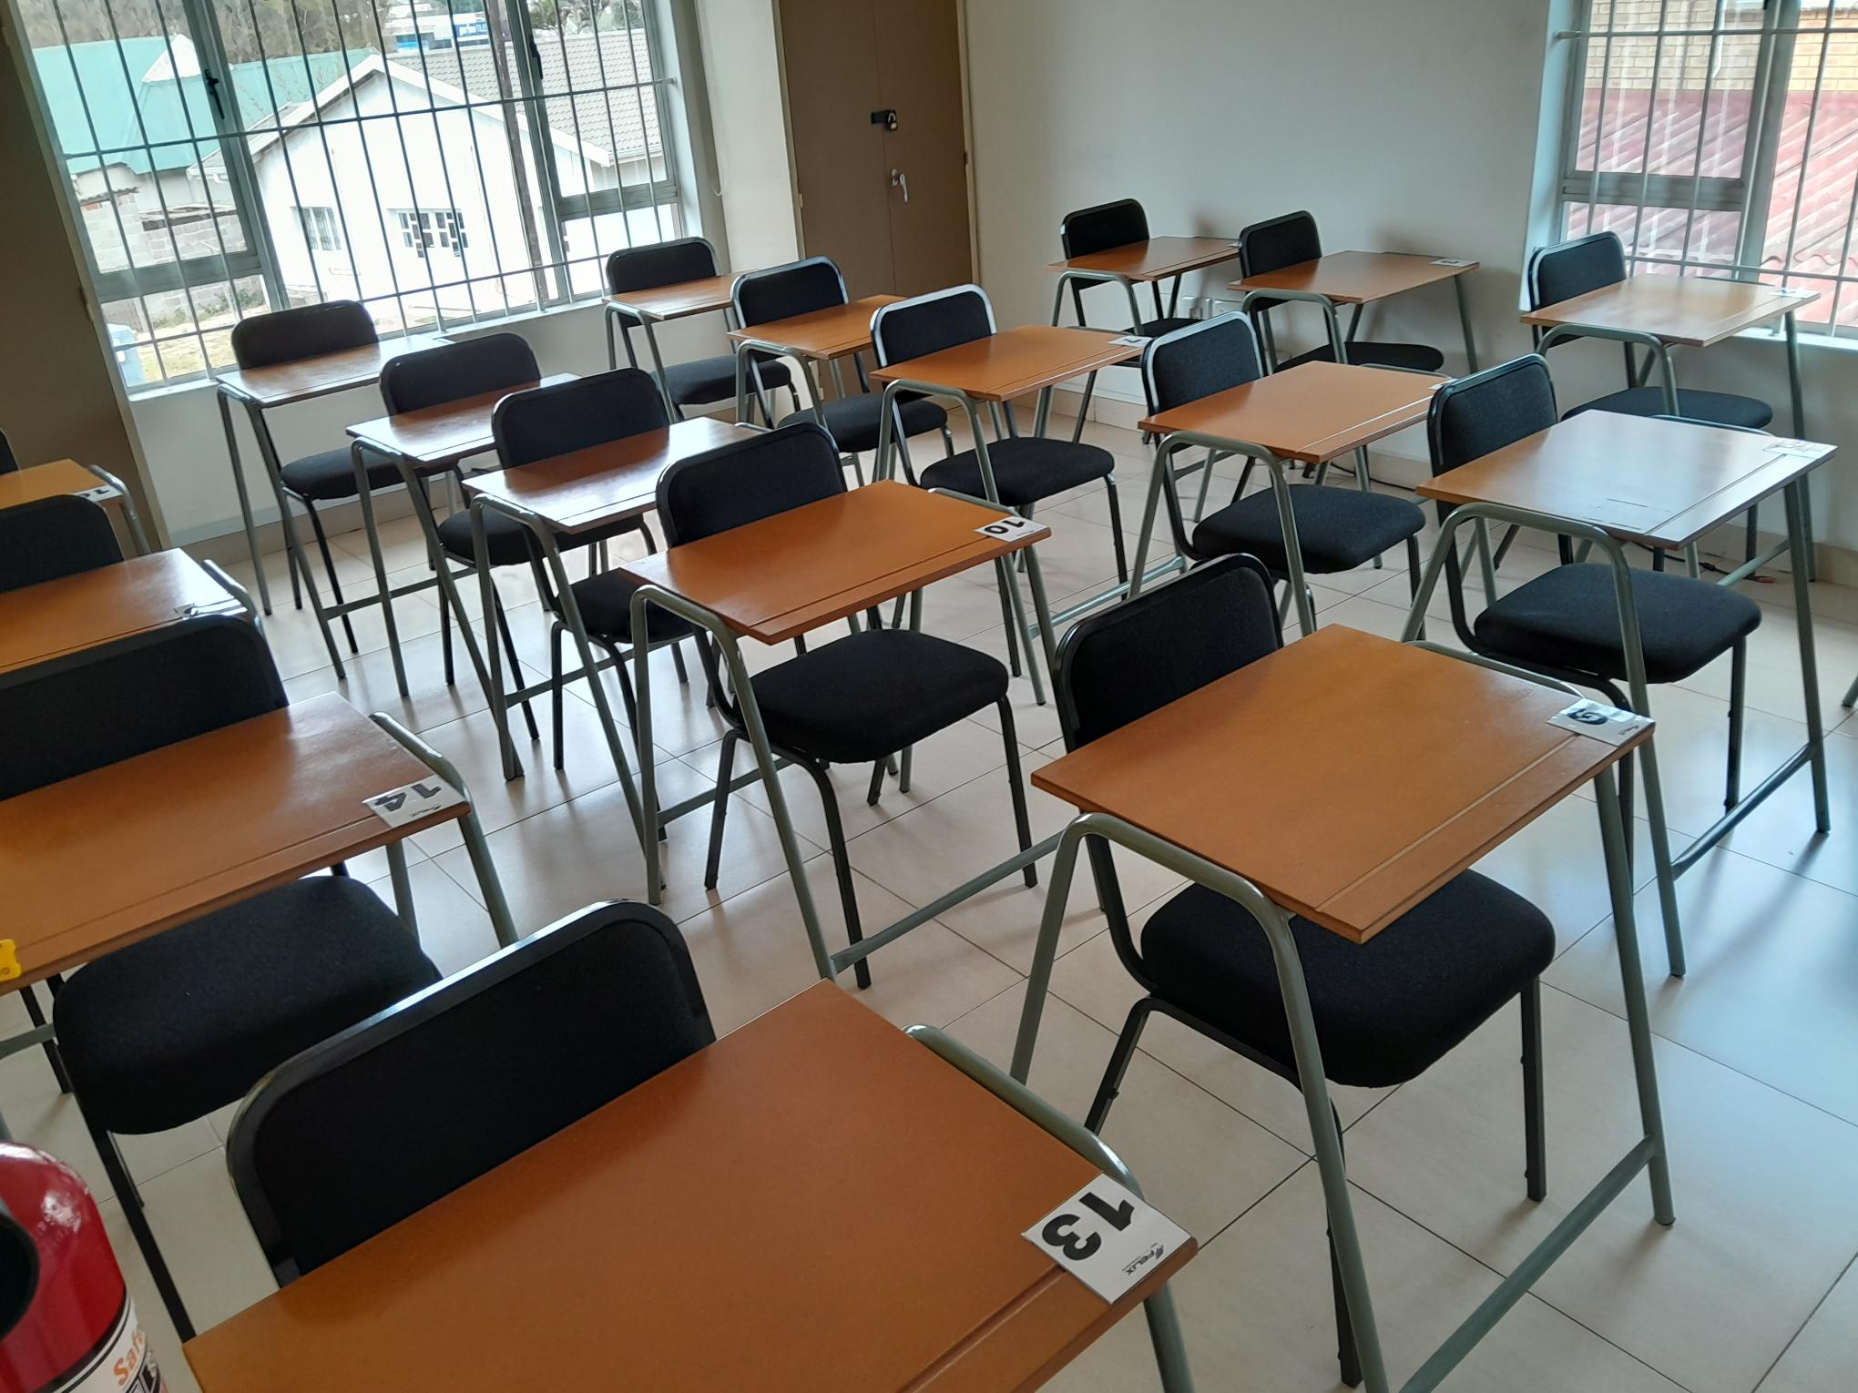
Accredited Assessment Centres
Assessment Centres = (TOTAL = 26)
Gauteng = 10 (Selby, Sandton, Pretoria)
Free State = 1 (Bloemfontein)
KZN = 3 (Durban)
Western Cape = 5 (Belville & George)
Limpopo = 2 (Tzaneen & Polokwane)
Eastern Cape = 4 (Mt Free, Umtata & Gqeberha)
Mpumalanga = 1 (Middleburg)

Slide 13
Implementing The OSF - Domains
Domain 5 - Certification
Candidates that Successfully Complete/Pass the EISA are Certificated by QCTO
The Passmark per Qualification is Determine by its Relevant QAS Addendum.
Frequency of EISA Exams per Annum is per SETA Decision/Planning.
A Learner has 2 Attempts at EISA Before Re-Enrolment as a New Learner.

Slide 14
Certification Statistics: Jan 2024 – Sept 2024
Process:
SETA:
Compilation of EISA Results
211 Certificates: Jan – Sept 2024
Insurance Underwriter (91784)
Insurance Underwriter (117329)
Claims Assessor (99668)
Investment Advisor (105021)
Long-Term Ins. Advisor (105022)
Health Care Ben. Advisor (105030)
Prof. Principal Executive (99574)
3 Months ISSUES
QCTO:
Approval EISA Results

Slide 16
QCTO Vision 2027
Vision:
Standardisation & Simplification of Quality Assurance (QCTO/SETA)
FOCUS:
Re-aligning ALL Legacy Qualifications to Occupational Qualifications
Develop Short-Skills Programs
Register ALL Occupational Qualifications as Learnerships
Increase Industry Consultations
INSETA WISHES TO HAVE FULL-TRANSITION BY 2026 (1 YEAR EARLIER THAN DEADLINE)

